Slide 1
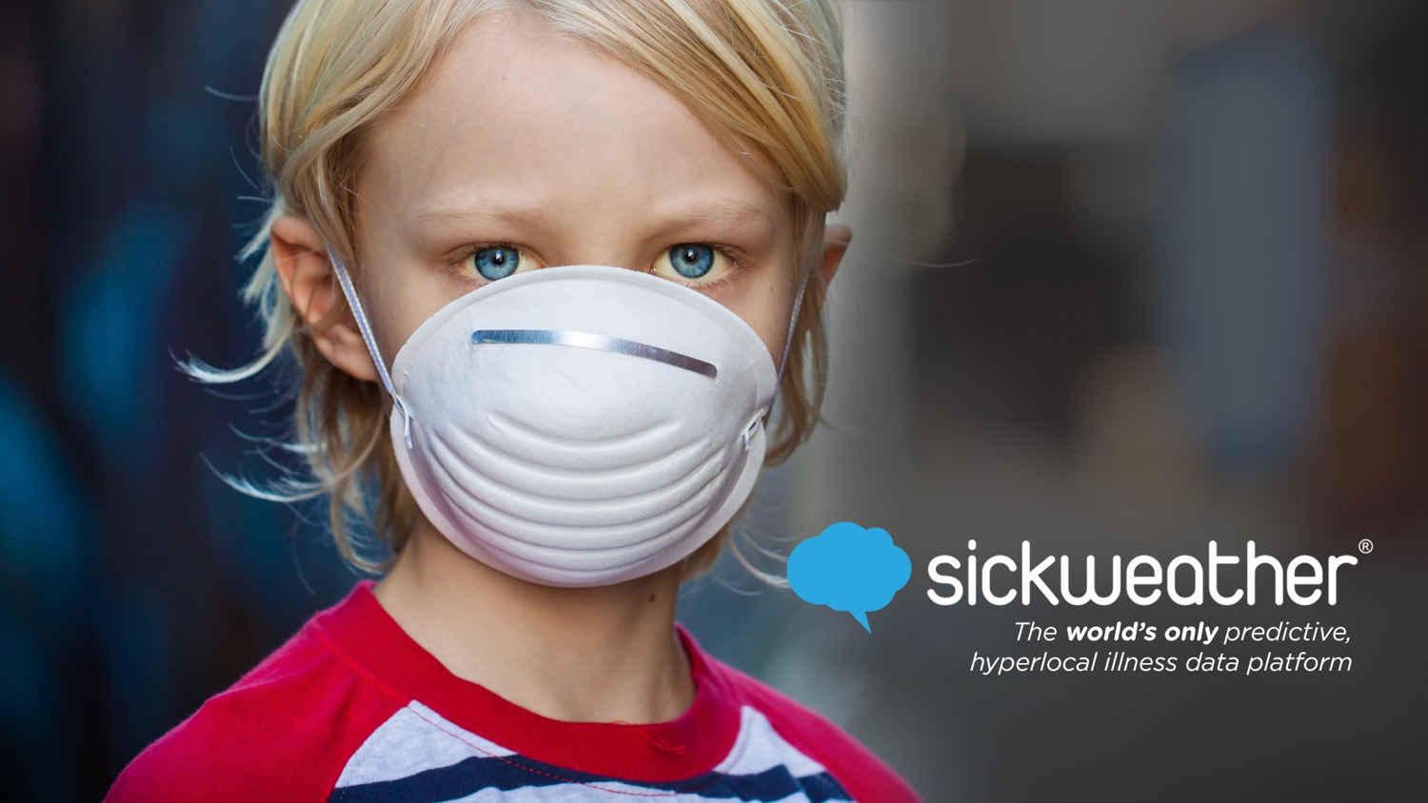

Slide 2
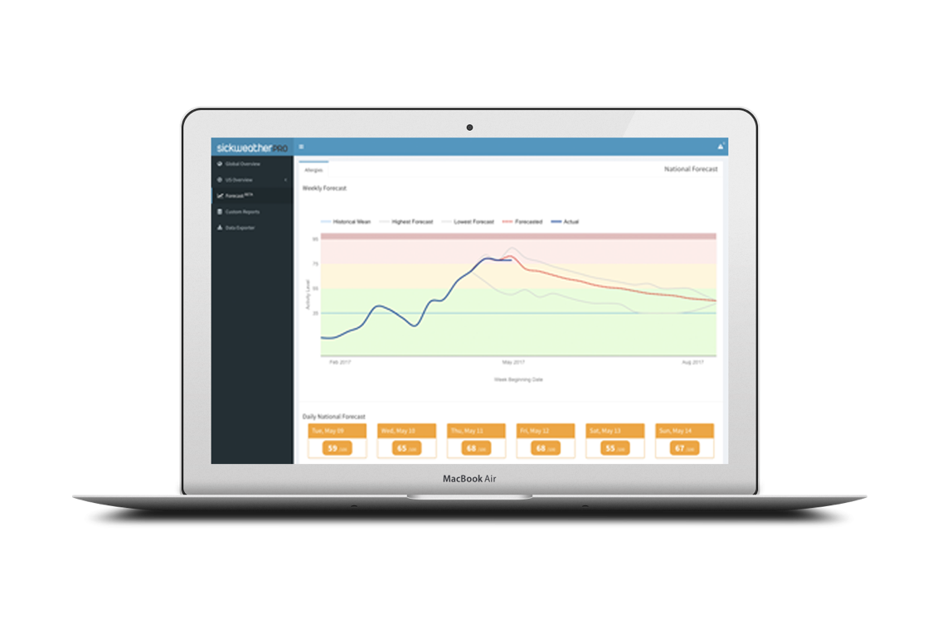
HOW IT WORKS
Sickweather knows where sick people are & where they will be with the world’s only predictive & hyperlocal illness data platform.
1
Patent Pending Data Collection
social media, crowdsourcing, consumer apps
2
Validation
3rd party sources: Nielsen, CDC, IQVIA, Quidel
3
Custom Modeling
15 week forecasts, SickScore® risk analysis

Slide 3
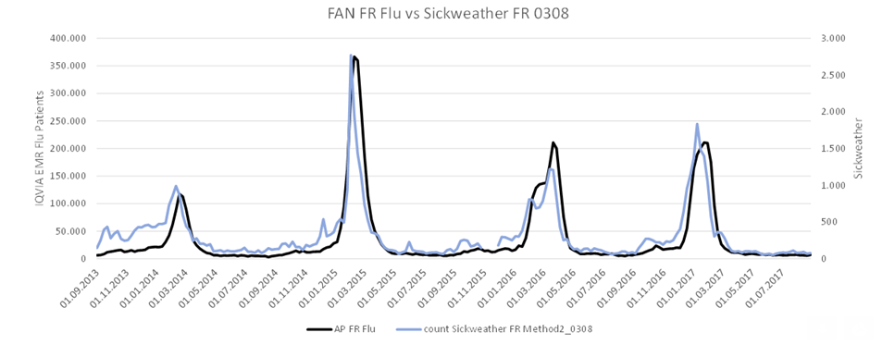
VALIDATION
Sickweather has correlations as high as 0.96r with CDC ILI in the US and with as high as 0.94r with IQVIA FAN in France

Slide 4
DIFFERENTIATORS
Real-time &
15 Weeks
Before CDC
91%
Accurate
Geolocation at
Street
Level
Supporting over
5 Billion
Monthly
API Requests

Slide 5
TEAM
Graham Dodge
Chief Executive Officer
Co-Founder
James Sajor
Chief Operations Officer
Co-Founder
Michael Belt
Chief Technology Officer
Co-Founder
Laurel Edelman
Chief Revenue Officer
Megan Milstein
VP, Technology
Bogdan Rau, MPH
Lead Data Scientist
& Epidemiologist
Kevin Quach
Data Scientist
& Biostatistician
Kaitlin Brennan
Marketing Manager
Ebele Mogo, DrPH
Epidemiologist & Researcher
David Switzer
Account Management & Media Relations

Slide 6
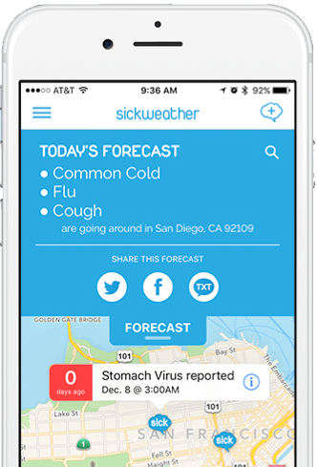
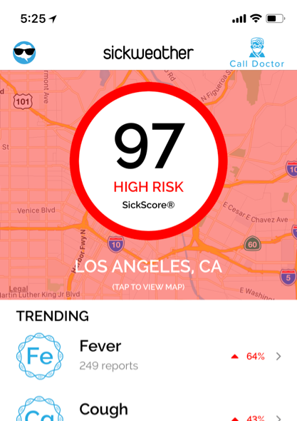
DIRECT TO CONSUMER
Over 325,000 downloads
“It tells you where all the sick people are!”

Slide 7
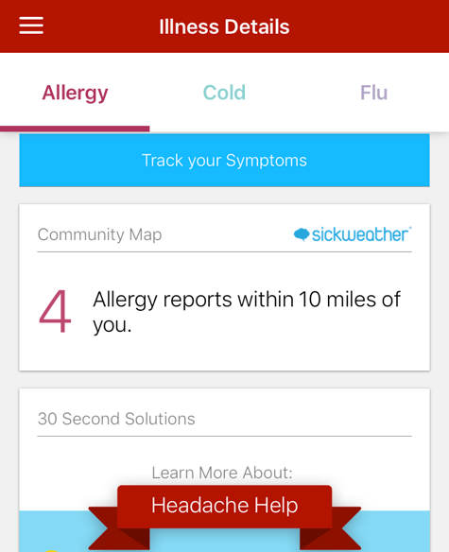
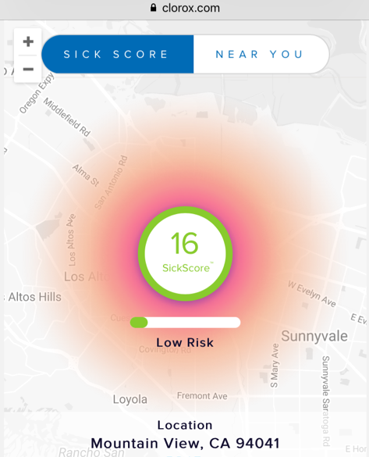
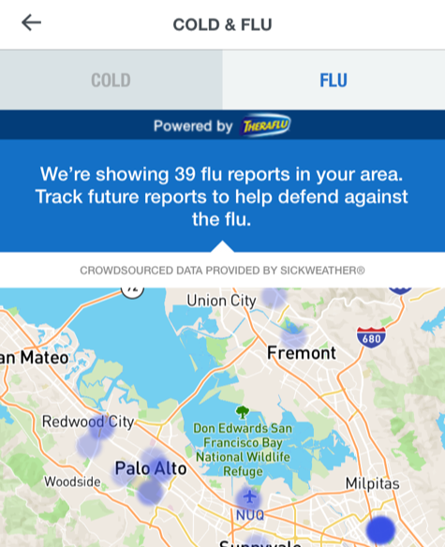
‘POWERED BY SICKWEATHER’ PARTNERS
Success: Sickweather has replaced the CDC as the flu data provider for the Weather Channel

Slide 8
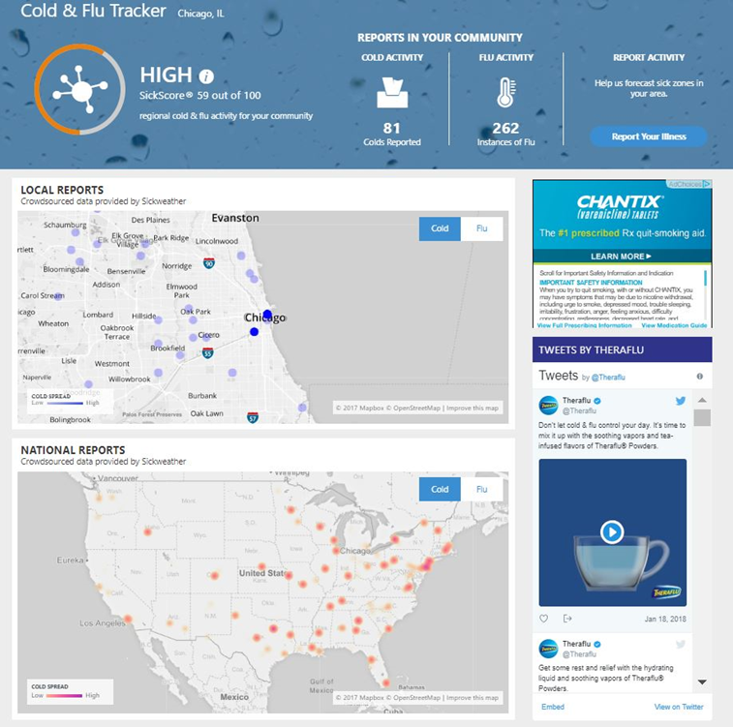
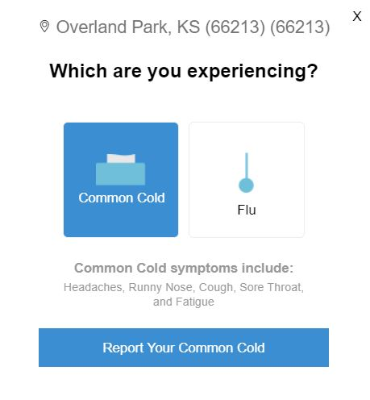
WEATHER APP & WEBSITE INTEGRATION
Estimated 10 Million DAU
20% increase in Cold & Flu Data to Sickweather

Slide 9
CURRENT PRODUCT/ MARKET FIT
Sickweather helps brands predict consumer intent & powers an estimated $320M in OTC/CPG annual ad spending
CONSUMER
PHARMA, OTC & CPG
PHARMACY & RETAIL
Success: GSK reported 2-3x better Click-thru Rates & 4% increase in Theraflu sales

Slide 10
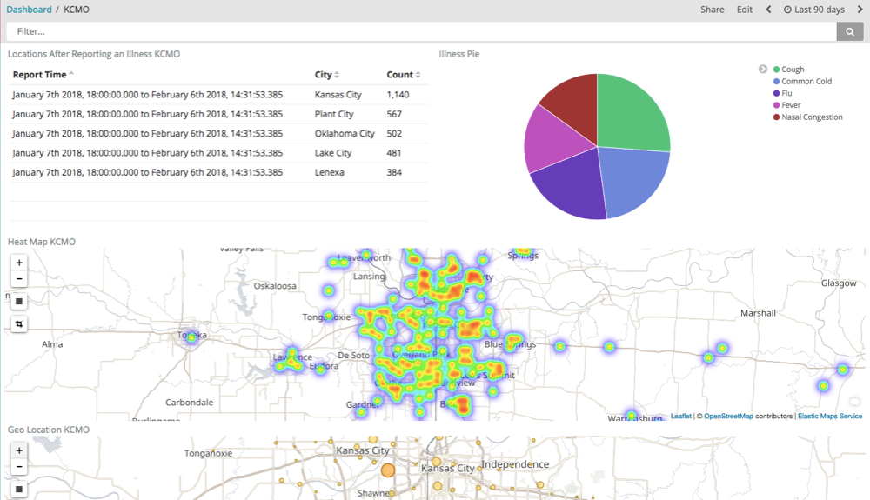
FUTURE: SMART CITIES & SENSORS
Sickweather is already piloting smart city public health technology with the Kansas City Public Health Department with budgets approved by city council for 2019 and beyond.

Slide 11
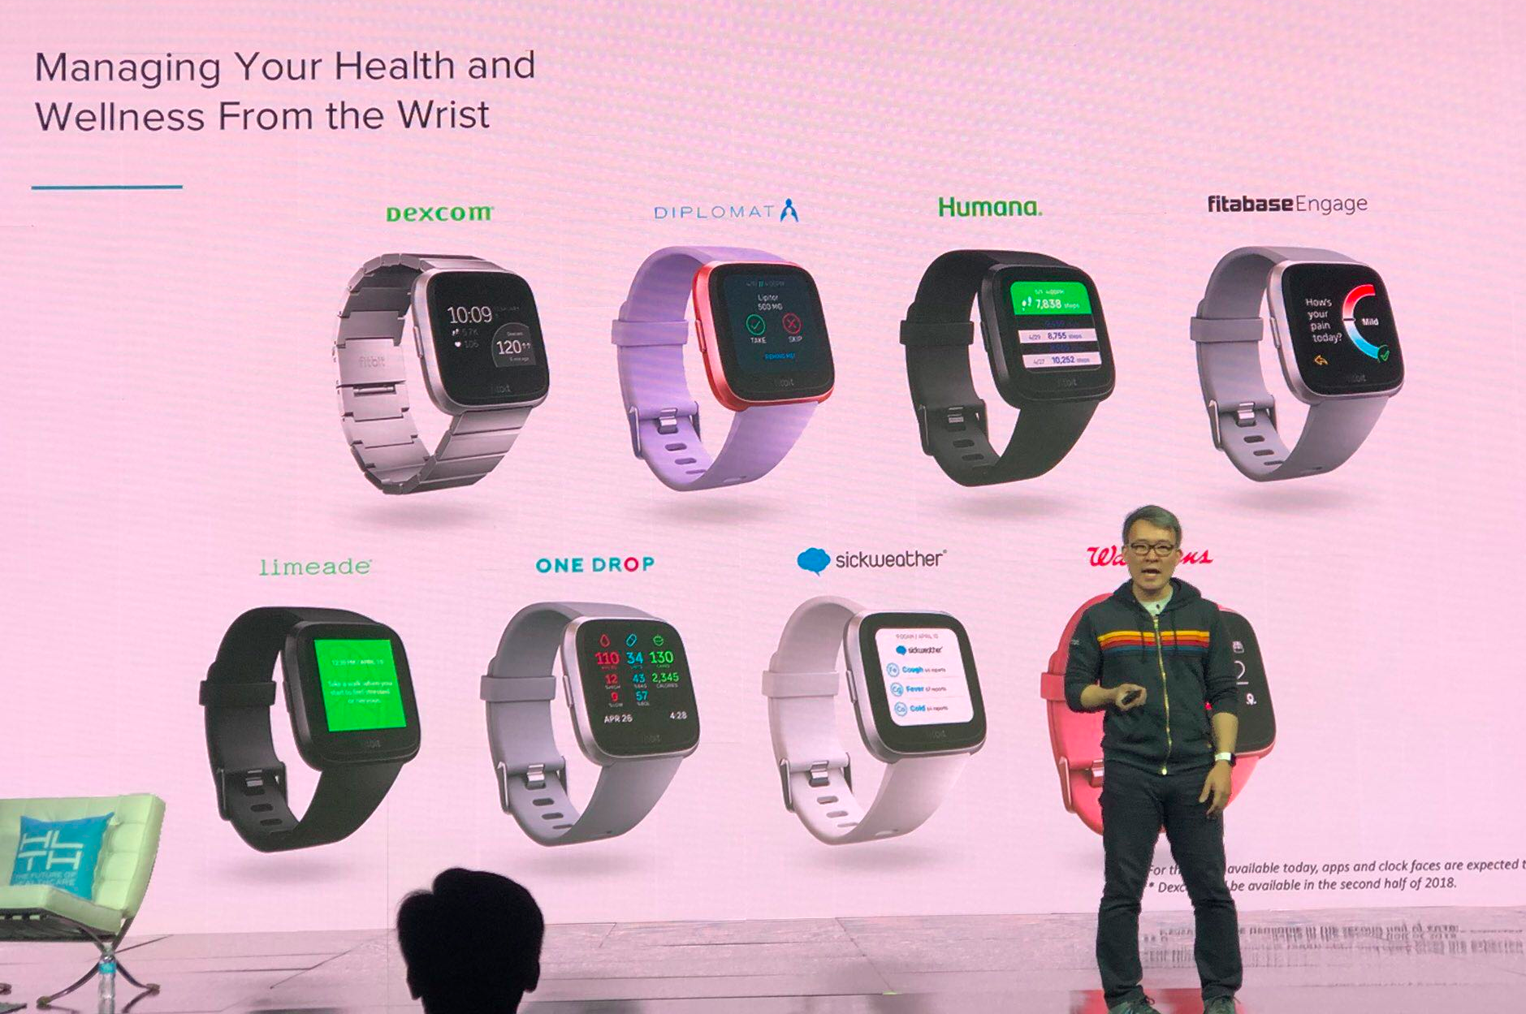
FUTURE: FITBIT USER REPORTS
Fitbit CEO James Park announcing Sickweather partnership at the 2018 HLTH Conference.

Slide 12
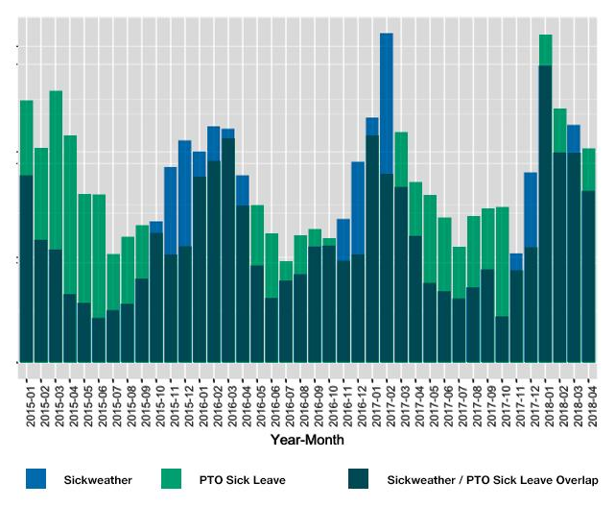
FUTURE: ABSENTEEISM RISK
Sickweather has partnered with the top disability insurer in the US & UK to prototype absenteeism / presenteeism risk & prediction tools.
“11 million Americans will fall ill, costing employers more than $9 billion in wages being paid to employees who are staying home sick”
Challenger, Gray & Christmas

Slide 13
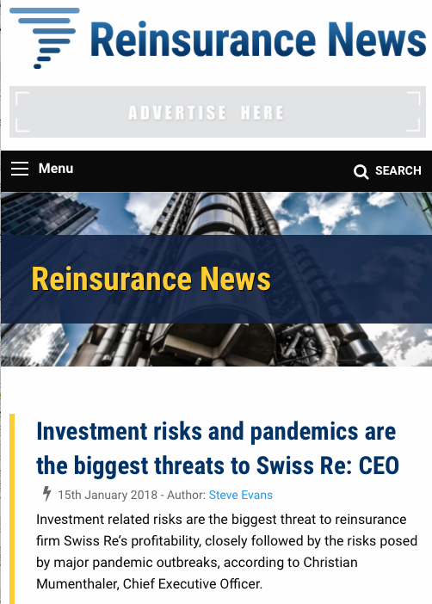
FUTURE: INSURANCE LINKED SECURITIES
“SickScore® Risk Index as an early warning parametric index to trigger backup reinsurance coverage […] has huge potential.”
Steve Evans Owner, Editor-in-Chief
Artemis - http://www.artemis.bm
ReinsuranceNe.ws
“In a world where data collected through social media has become controversial, Sickweather is illustrating how these methods can be used for both public and private good. However, being on the cutting edge of technology means having to educate potential customers of the full use of the information being provided. Exploring the possibility of revenue stabilization insurance in a thought piece can serve this purpose, and create an avenue of growth for insurance based upon big data metrics such as Sickweather’s SickScore®.”

Slide 14
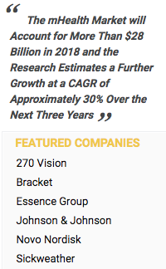
MARKETPLACE
$28 Billion Global mHealth market with 30% CAGR

