Slide 1
July 2019
Restaurant Partner Lifecycle Content Audit
Notes:
Difference between ----> More of the why?

Slide 2
CONTENT AUDIT GOALS
Identify and execute ways to reduce churn and increase ARPU through content marketing (emails, blogs, ebooks, social, web, etc.)
Identify and locate communication gaps in our marketing content for the various stages of sales and client cycle.
Discover and implement processes and/or content that could be automated to increase rep efficiencies.
Gain an in-depth understanding of ChowNow’s current & past B2B content landscape.

Slide 3
AUDIT FINDING METHODOLOGY
To uncover an accurate and comprehensive view of all ChowNow’s marketing content, the following processes were conducted:
Audit of Yesware templates for entire restaurant partner’s onboarding and lifecycle.
Audit of Milestone and Client Nurture email programs in Marketo.
Audit of ChowNow’s live links library of eBooks, Blogs, Whitepapers, and other Educational Downloadables.
Audit of ChowNow’s B2B website and Marketing Store.
A Marketing Content Survey with the AC and Restaurant Success Teams.
Notes:
Email is prevalent theme! ChowNow loves content (and for good reason) What can be refreshed for clients, what can be tweaked and what needs to be created from scratch.

Slide 4
CURRENT LIFECYCLE WINS
ChowNow’s processes and programs supporting restaurant partner lifecycle retention.
RMMS are equipped with good documentation (in the form of Yesware templates) for every possible issue that could arise from login issues to upsells.
Current Milestones are strategically triggered to hit clients at the optimal time in their ChowNow journey.
Nurture program takes the time burden of training new restaurant partners on the basics of navigating the ChowNow’s Dashboard off ACs and RSMs.
Majority of ChowNow marketing collateral is direct and easy to understand, with clear calls to action or a way to contact a RSM/RMM or Customer Service.
94% of our Restaurant Success Team believes our current content is easy for restaurant partners to understand.

Slide 5
There are key gaps in lifecycle content and an overall lack of detailed client lifecycle analytics and data.
OBSERVATIONS
The Yesware templates creation and implementation are currently segmented from the growth marketing channel strategy, making it challenging to track the emails’ wins or loses.
Milestone email program is not actively pushing upsells to the ChowNow Marketing Store or driving RSM/RMM booked consultations.
Nurture Email program and marketing collateral does not highlight the long-term value of ChowNow.
Blogs and B2B ChowNow website is optimized to be a sales funnel and drive new leads––not client retention.
Notes:
RSM/RMM = reason churn is low. Differentiating b/w client lifecycle market and client lifecycle retention. Acknowledge that attention hasn’t been paid to current life cycle or a dedicated team, so obvi areas of improve, so I’ve listen some below speficially.

Slide 6
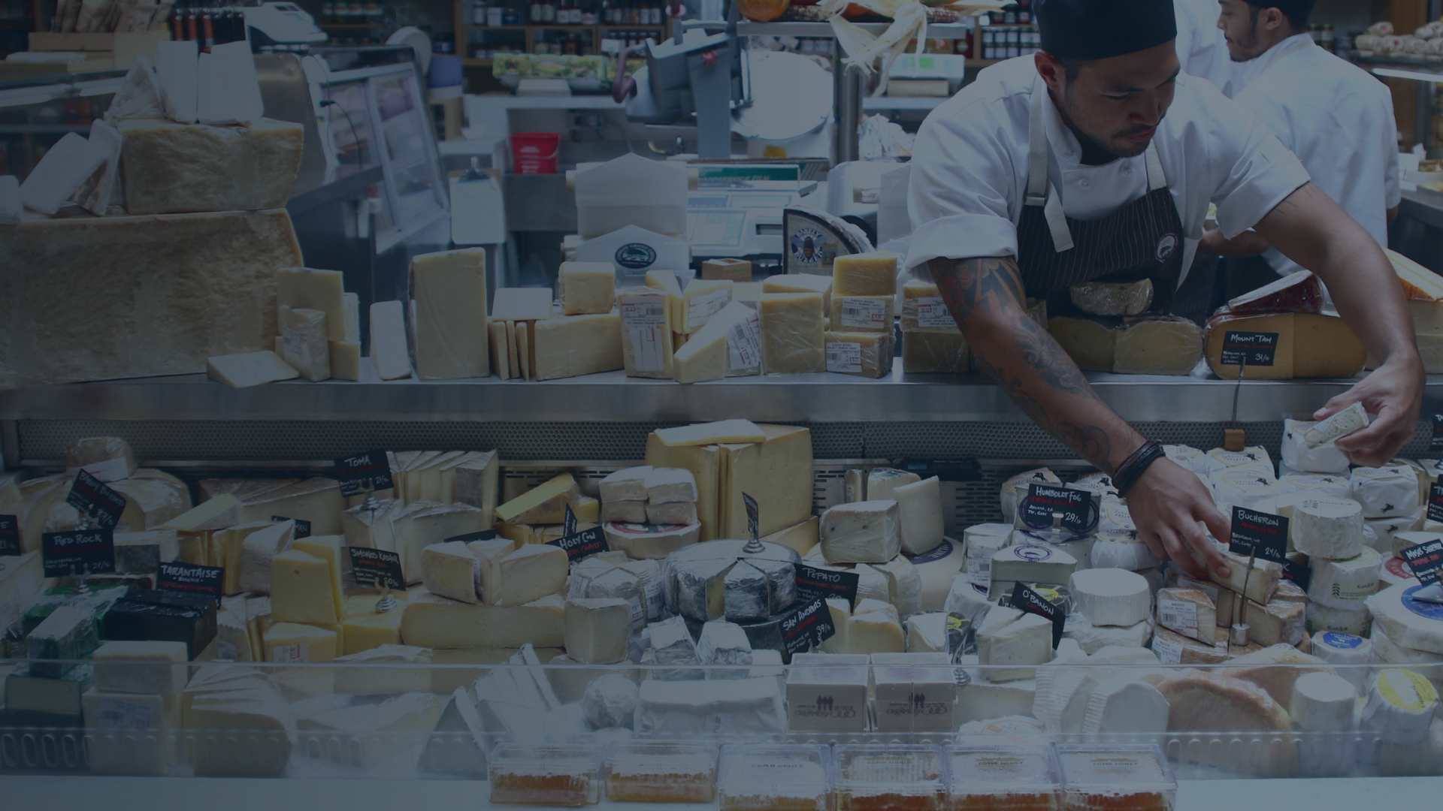
Yesware Templates
FARMSHOP // Santa Monica, CA

Slide 7
YESWARE TEMPLATE GAPS AND OPPORTUNITIES
Marketing email best practices are not being implemented, creating an inconsistent use of subject lines, soft CTA’s and body copy content.
Lack of automation or triggers makes tracking the success of the Yesware templates virtually impossible.
Updated ChowNow brand style and voice has not been implemented in Yesware.
With 2+ year-old template copy in Yesware, not all ChowNow product features or marketing add-ons are showcased.
Notes:
Communicating/checking in with...why “Not action we want them to take.” Their goal is to facilitate a consultation. Disconnect between CTA → create alignment

Slide 8
YESWARE LACK OF EMAIL BEST PRACTICES EXAMPLE
Notes:
As you can see in this template example in Yesw
are, we are not actively utilizing email best practices. 1) Subject line is not descriptive/specific or enticing, CTA is buried in body copy and doesn’t close out on a hard CTA 2) Old marketing collateral is linked in this email and it’s lacking stats to showcase the MT’s value 3) Voice is not consistent with ChowNow brand. ------> REWRITE email so audience can visualize opportunity.

Slide 9
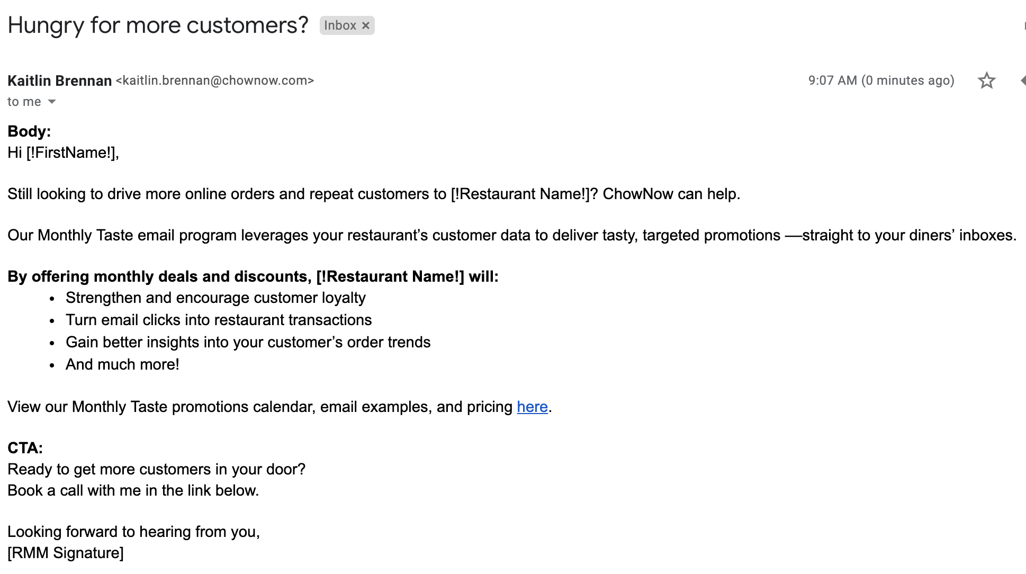
YESWARE EMAIL REWRITE
Notes:
As you can see in this template example in Yesw
are, we are not actively utilizing email best practices. 1) Subject line is not descriptive/specific or enticing, CTA is buried in body copy and doesn’t close out on a hard CTA 2) Old marketing collateral is linked in this email and it’s lacking stats to showcase the MT’s value 3) Voice is not consistent with ChowNow brand. ------> REWRITE email so audience can visualize opportunity.

Slide 10
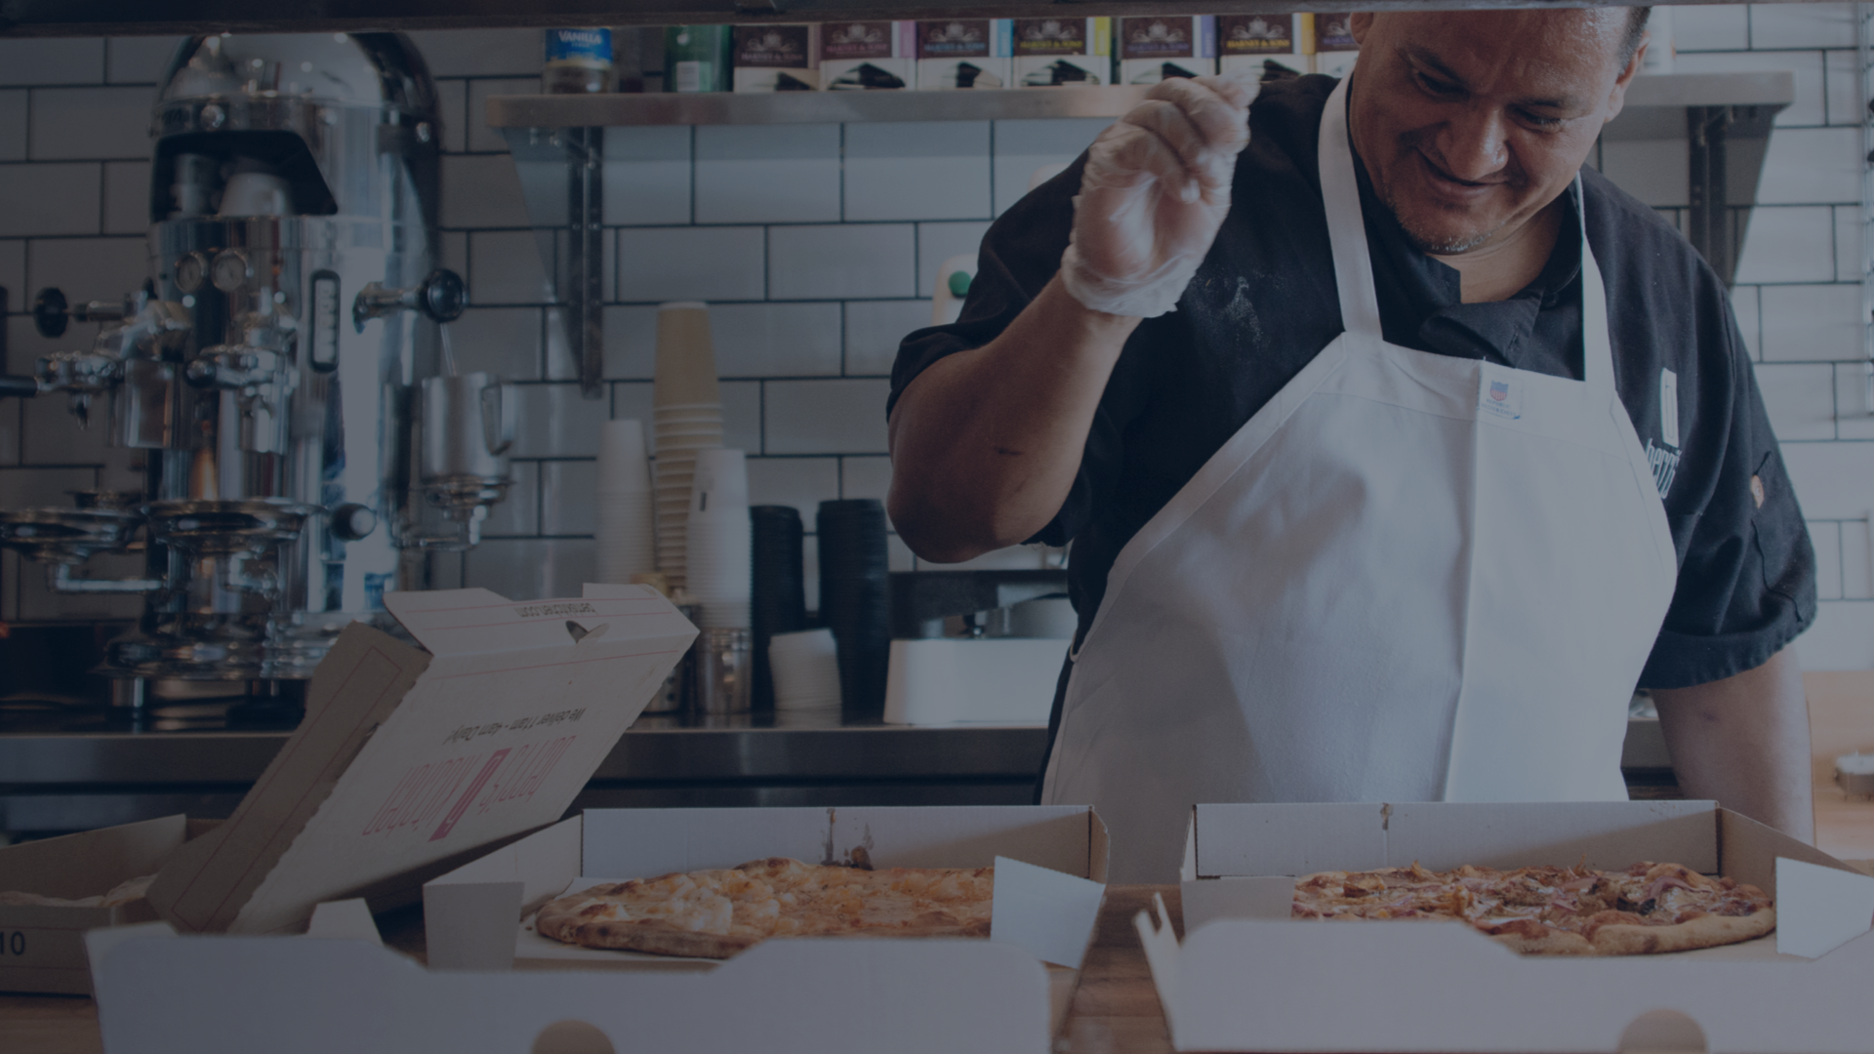
Milestone Email Program
BERRI’S KITCHEN // LOS ANGELES, CA

Slide 11
MILESTONE EMAIL PROGRAM GAPS AND OPPORTUNITIES
Current Milestone Program is only hitting newer clients, many older ChowNow restaurant partners have never received a Milestone.
Milestones don’t adequately highlight all of ChowNow’s marketing store add-ons or highlight case studies, success stories, or statistics. And a majority of the linked content is out of date.
Milestone Emails are pushing restaurant partners to the dashboard, not booking consultations with their RSM/RMM.
Milestone Emails are currently 2+ years old and don’t line up with ChowNow’s current design and brand voice.
Notes:
*Many of our current B2B emails programs and templates suffer from the same pain points, making them great opportunities for easy wins!

Slide 12
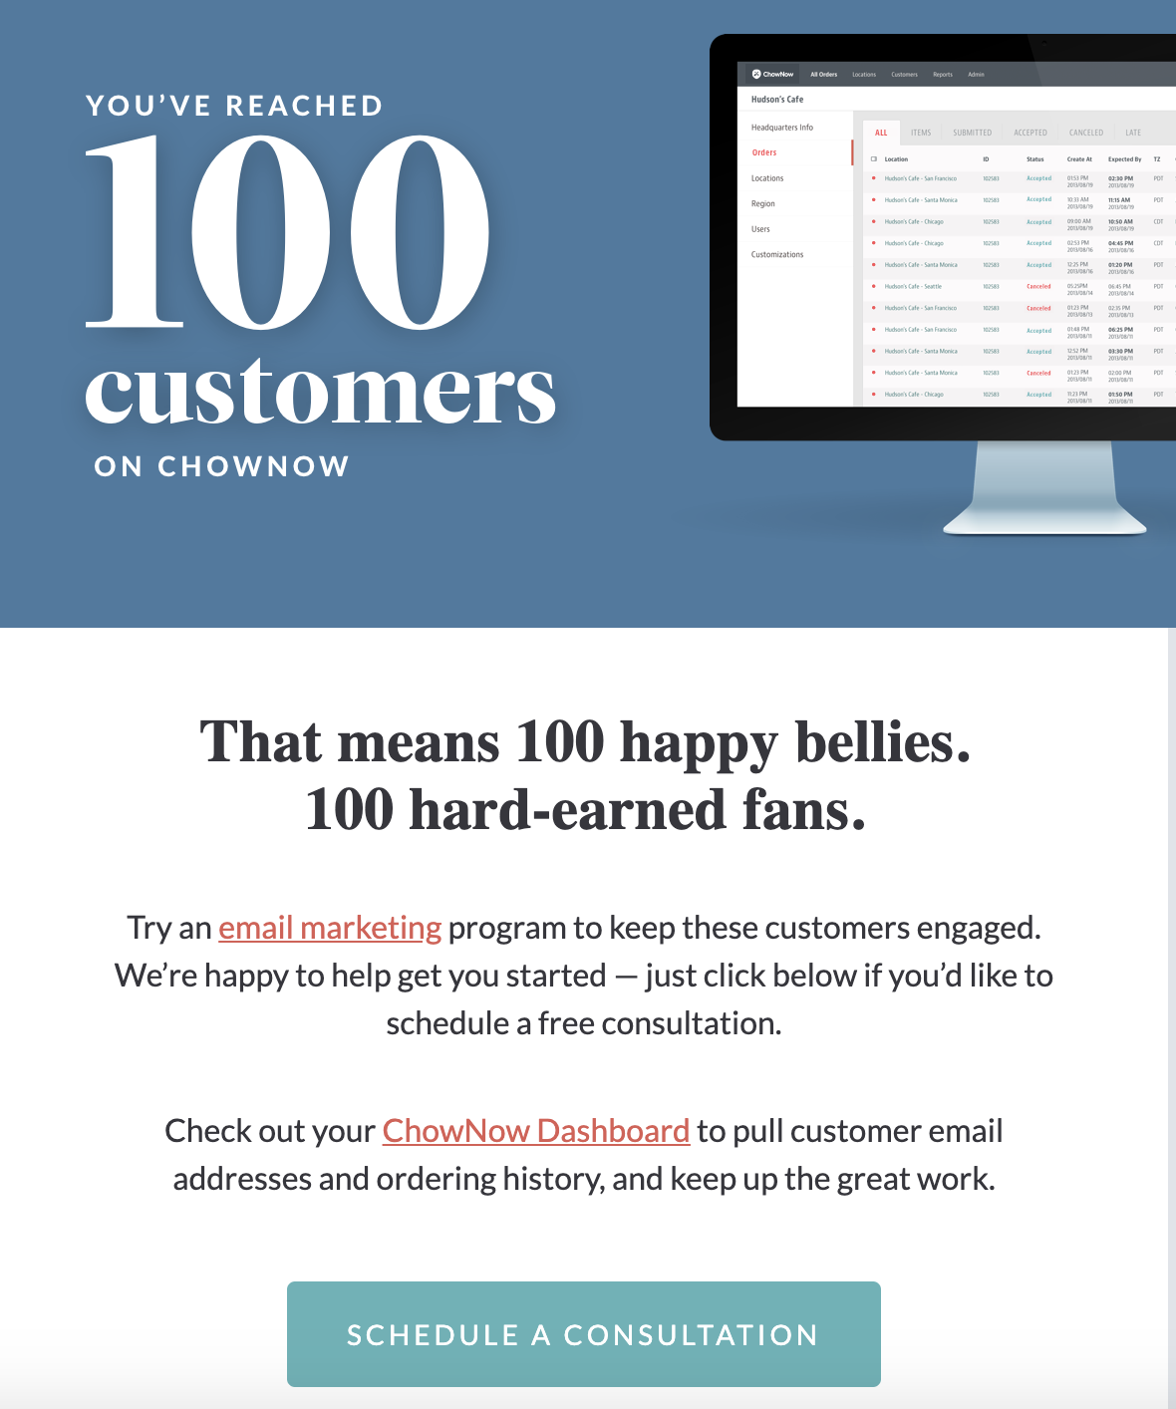
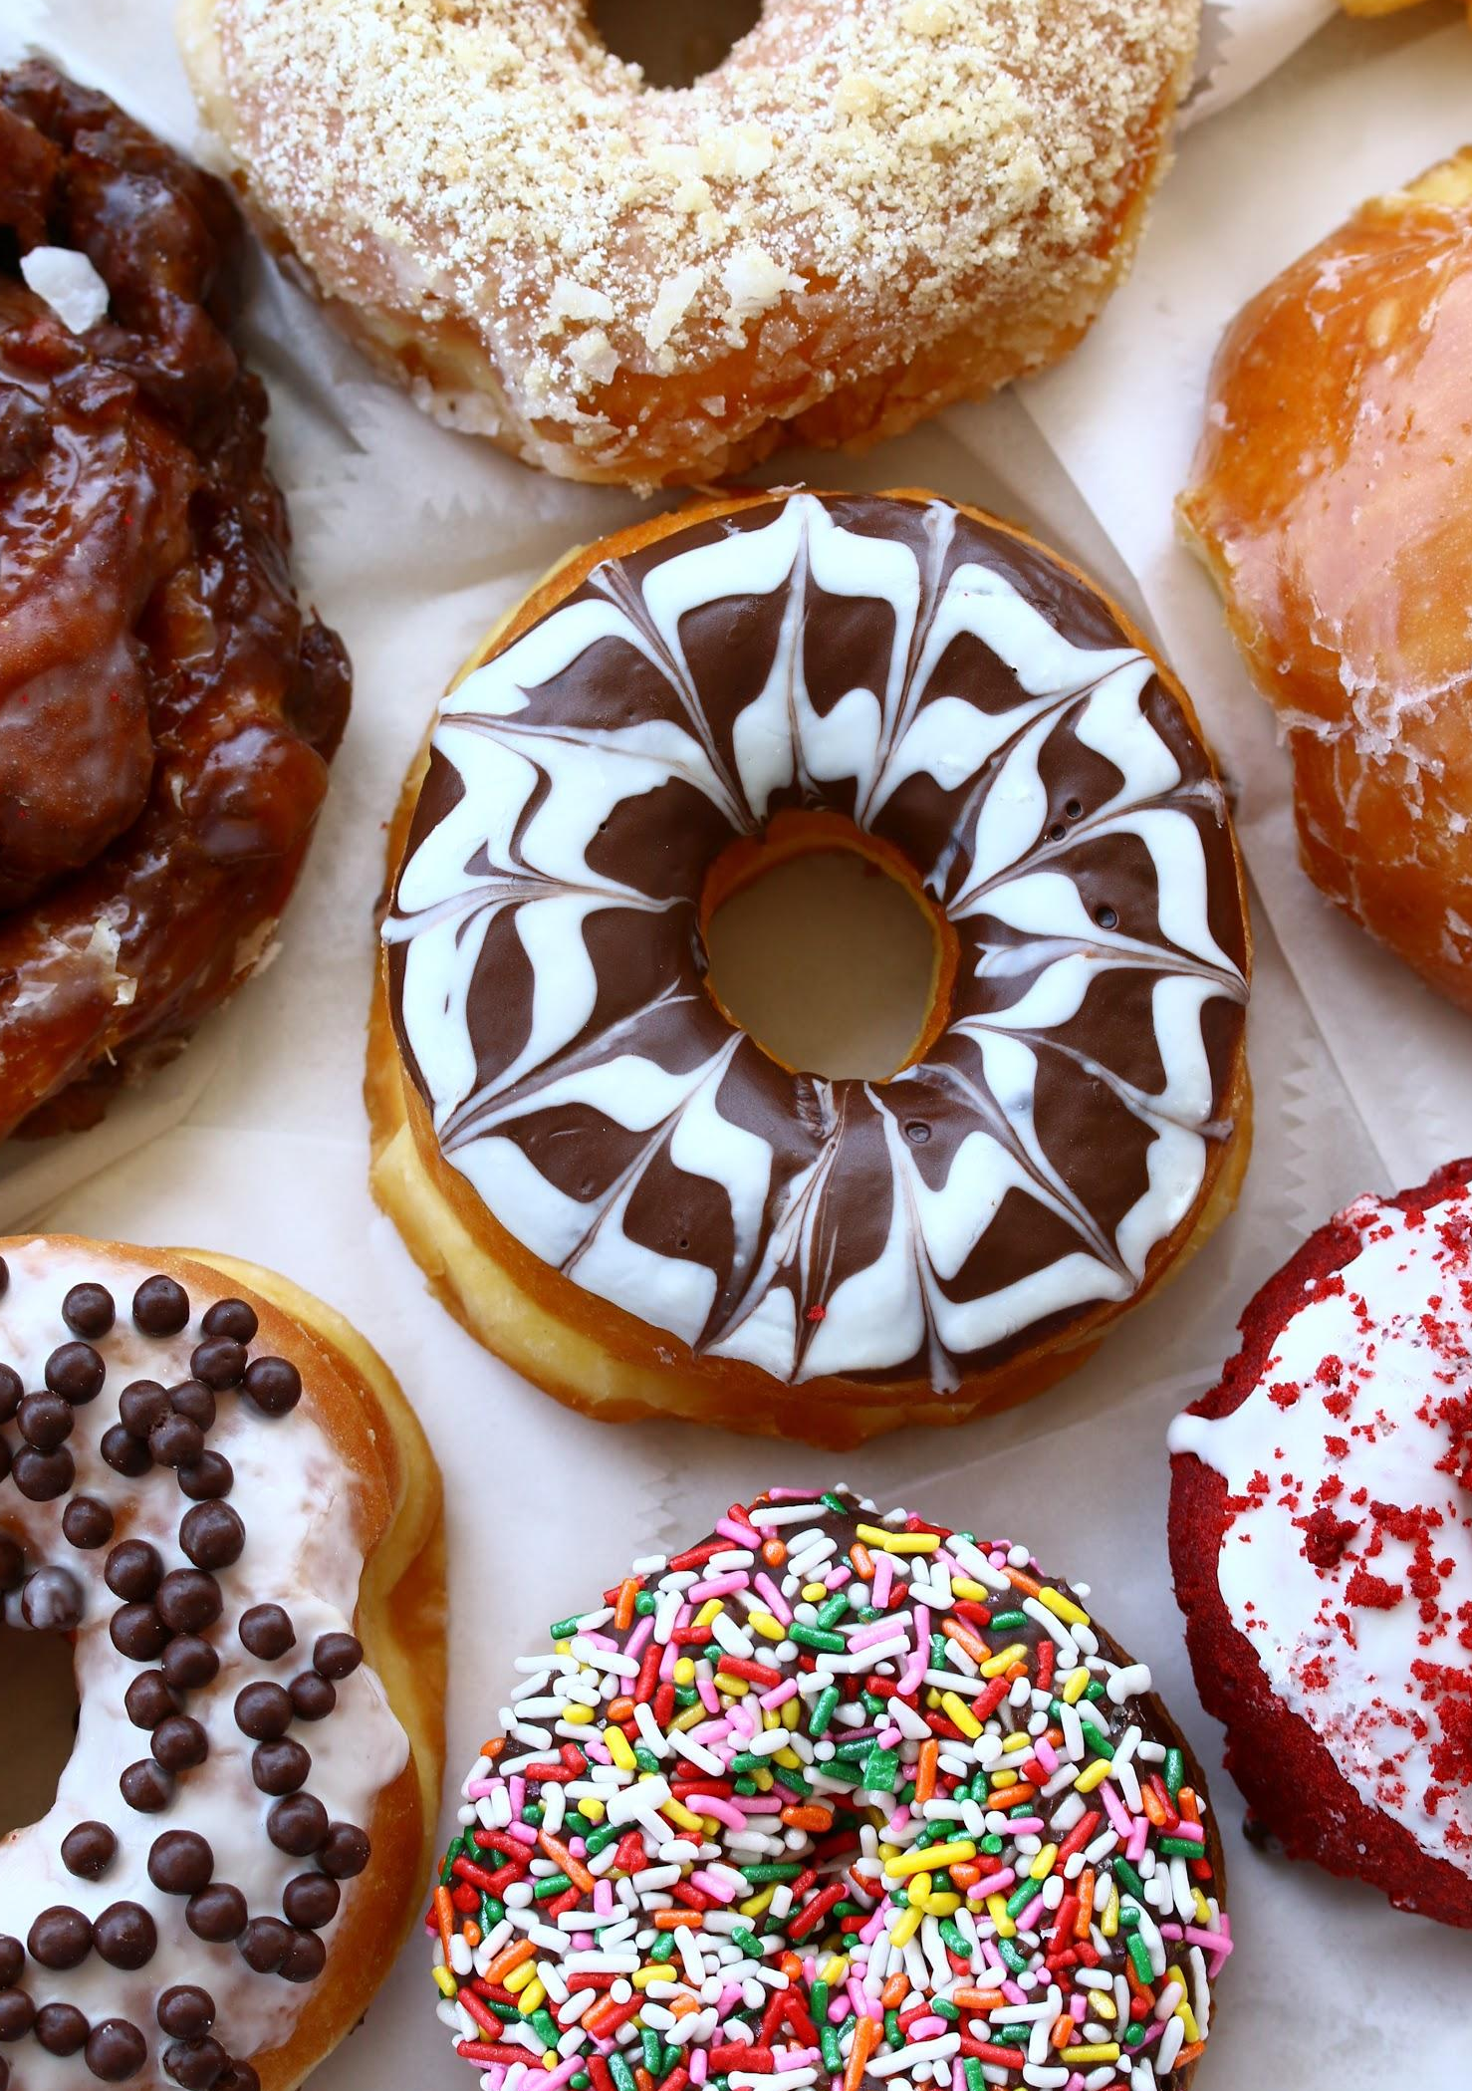
MILESTONE EMAIL PROGRAM EXAMPLE
Giving restaurant partners three CTAs to choose from.
Content doesn’t showcase the value of an email marketing program and isn’t linked to anything that highlights the value of this product either.
Off-brand design and copy style.
Notes:
Animate Nurture program for post 90-days …..how can we tighten up that messaging? Setting up for success in first 90-days /// We need something else as well “New restaurant acquistions…” great opp. To repurpose current content.

Slide 13
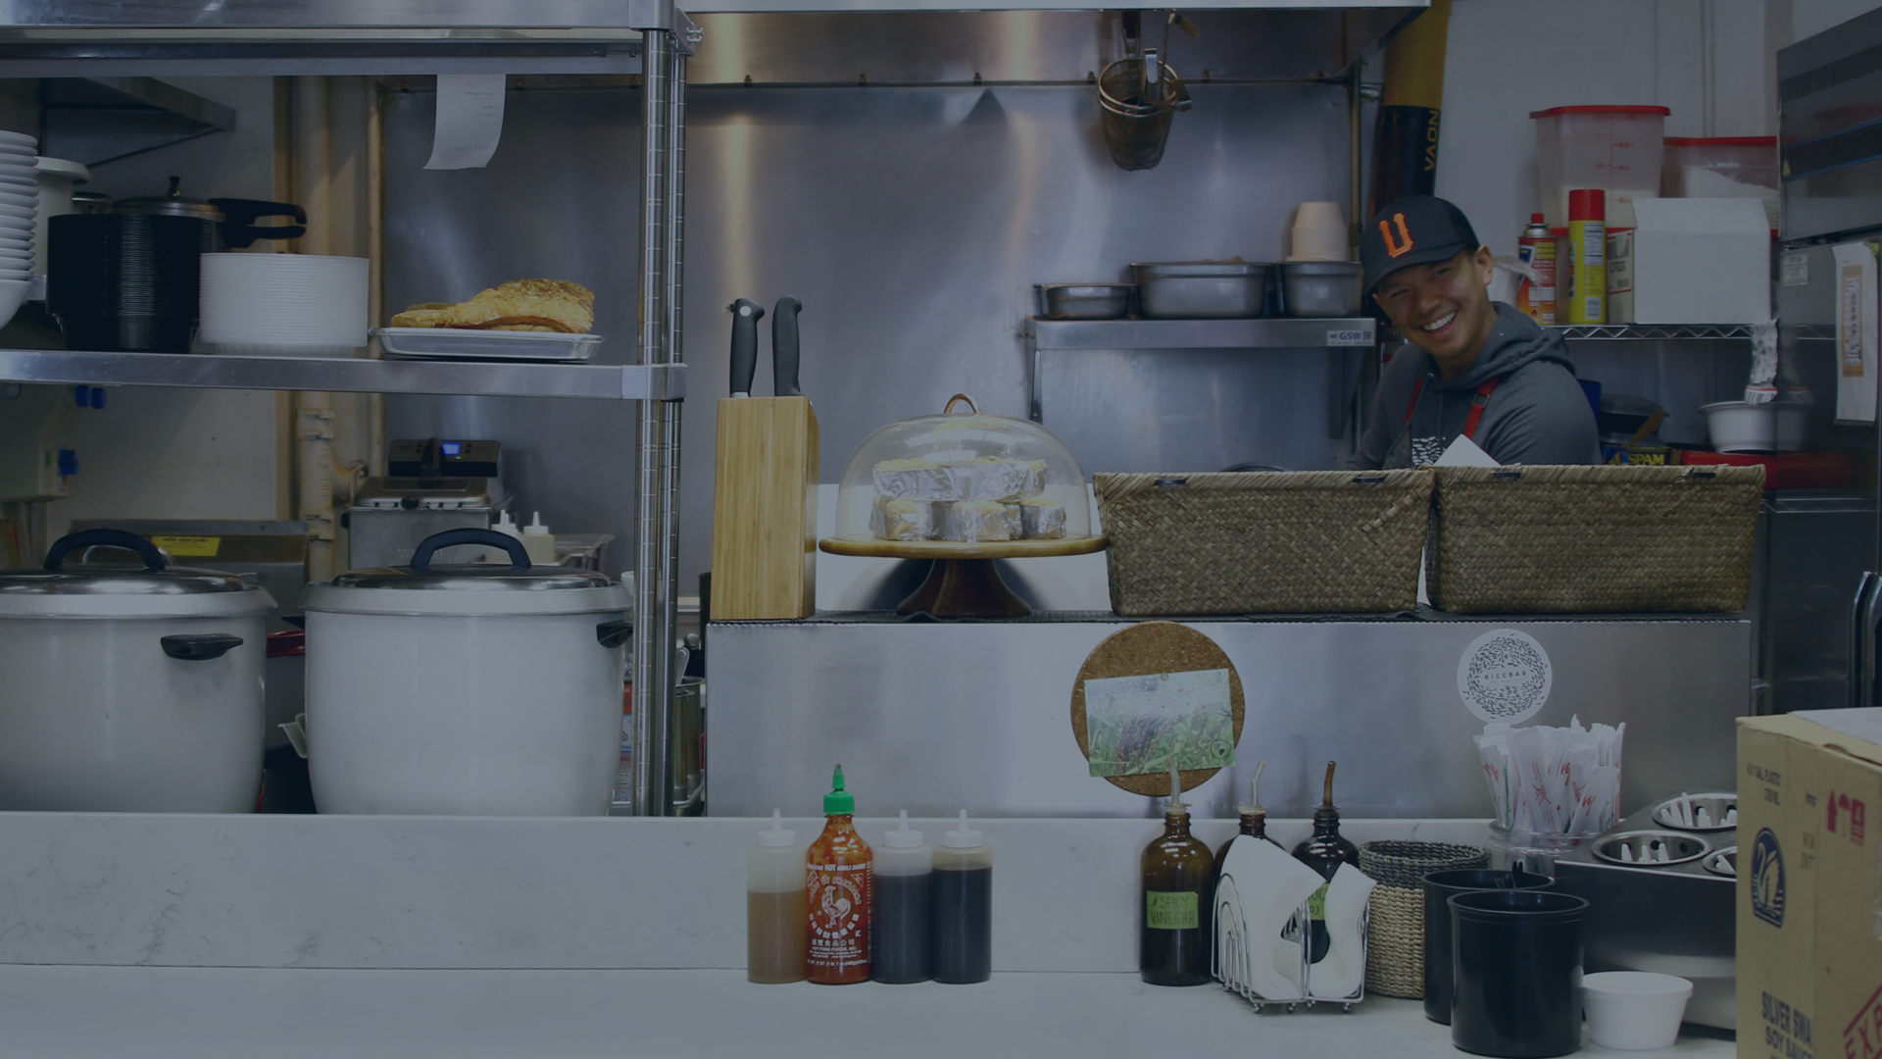
Nurture Email Program
CHARLES OLALIA // Chef & Owner, Rice Bar

Slide 14
EMAIL NURTURE PROGRAM GAPS AND OPPORTUNITIES
Content is written and geared towards helping ramp up clients on our platform but lacks an ongoing, long-term nurture strategy.
Nurture emails don’t adequately highlight all of ChowNow’s marketing store add-ons or highlight case studies, success stories, or statistics.
A majority of the linked content is out of date and off brand and doesn’t showcase or highlight ChowNow’s long-term value.
75% of AC’s don’t believe our content adequately covers all of our on client’s onboarding needs.
Notes:
*Many of our current B2B emails programs and templates suffer from the same pain points, making them great opportunities for easy wins!

Slide 15
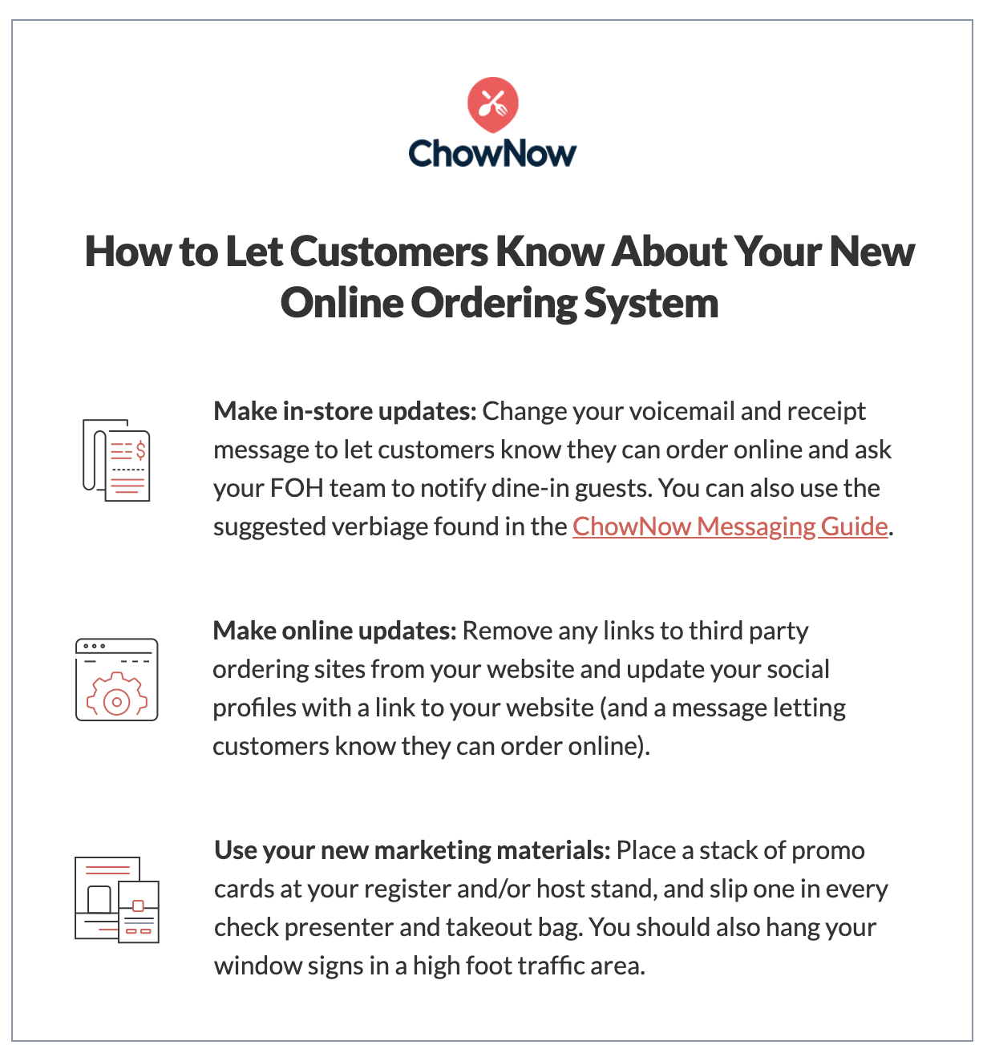
NURTURE EMAIL PROGRAM EXAMPLE
Only link is to out-of-date and off brand content.
Missing stats or data to validate our claims and showcase the value of our ChowNow product .
Program only lasts for restaurant partner’s first 90 days.
Off-brand design and copy style.
Notes:
Bring in learnings from brand book (real life imagery to humanize our content) Missing out on opportunity to showcase value ….Show not tell.

Slide 16
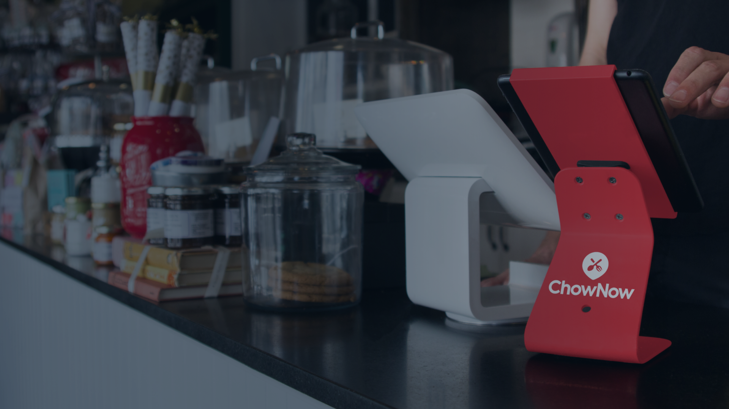
Collateral
SWEET BUTTER KITCHEN // Sherman Oaks, CA

Slide 17
MARKETING COLLATERAL GAPS AND OPPORTUNITIES
Content is created and designed to gather new sales leads not nurture live clients.
Some content is missing CTAs or a push to schedule a consultation with a RSM/RMM or CS agent.
Not everything we are selling in our marketing store has one-sheet and/or blog post to support it or help upsell.
Some collateral that is linked in our live email campaigns has not been updated to the new brand and style guidelines.
Notes:
Collateral = ebooks, whitepapers, case studies, how-to downloads……..”Create purpose built content. Open loop. “Close that communication gap by adding hard CTAs” “For past year, growth marekting focus on generating new leads...never had dedicated content marketing specialist….groundwork laid to repurpose for live clients, opportunity to tweak.” Not starting from a bad place or not doing something we were supposed to be doing.

Slide 18
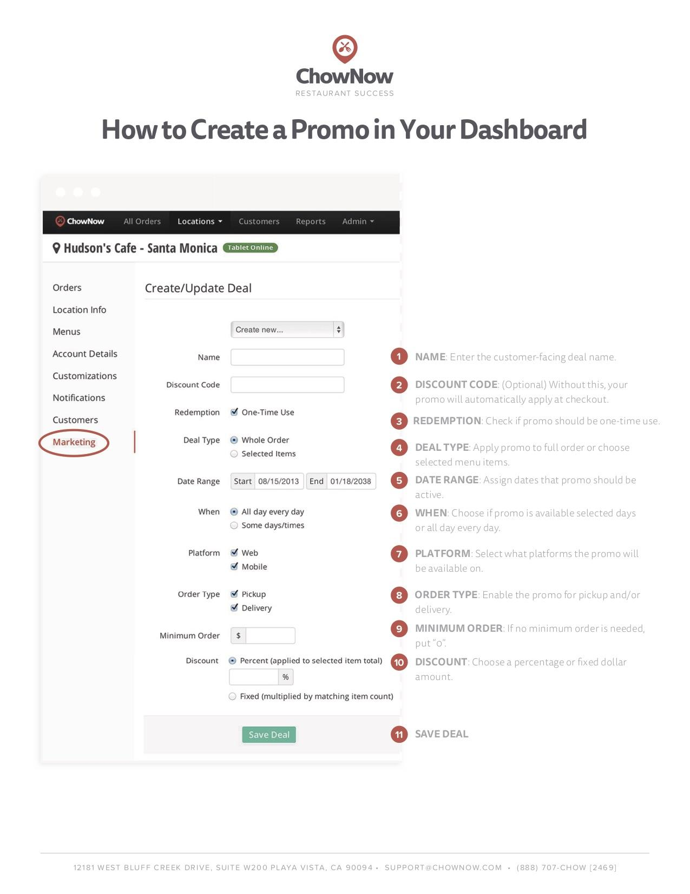
COLLATERAL - OLD BRANDING EXAMPLE
Off-brand design and copy style.
Copy isn’t optimized and the design and instructions are fighting for attention.
Missed opportunity to add CTA to contact RSM/RMM or CS
Missed opportunity to link to blog post on restaurant promotions best practices.
Notes:
Off-brand design and copy style. ---> make specific brand/copy suggestions. Focus on how we can make it better. Other company examples. For showing before and after.

Slide 19
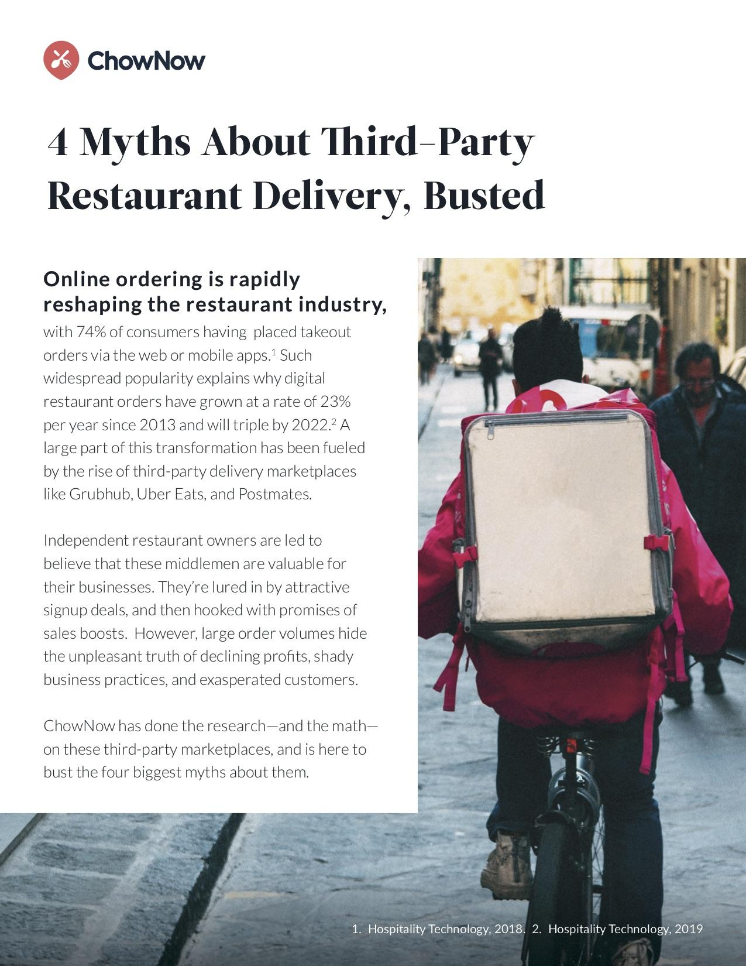
COLLATERAL - MADE FOR SALES EXAMPLE
Opportunity to personalize our content for specific audiences.
Minor copy tweaks + CTA update
Opportunity to link more updated, relevant content in Yesware templates and other email programs.
Continuing to educate on the value of ChowNow.
Notes:
Off-brand design and copy style. ---> make specific brand/copy suggestions. Focus on how we can make it better. Other company examples. For showing before and after.

Slide 20
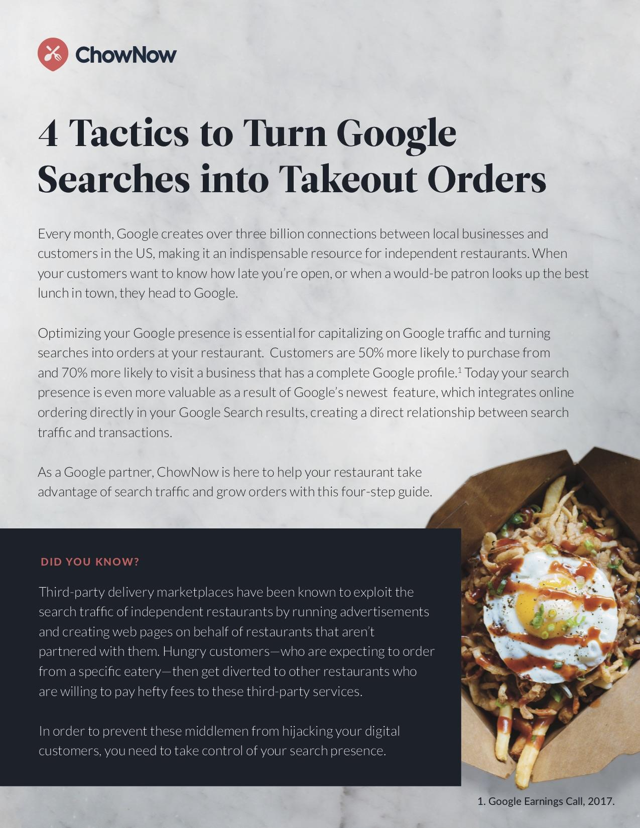
COLLATERAL - MISSING CTA EXAMPLE
Opportunity to upsell current clients.
Simple CTA change.
Opportunity to recycle this copy in upsell emails + other marketing campaigns.
Continuing to educate on ChowNow’s marketing offerings + services.
Notes:
Off-brand design and copy style. ---> make specific brand/copy suggestions. Focus on how we can make it better. Other company examples. For showing before and after.

Slide 21
ChowNow Blog & Marketing Store
RIZE THAI SUSHI // Santa Monica, CA

Slide 22
CHOWNOW BLOG GAPS AND OPPORTUNITIES
While blog topics are strategically selected to focus on top industry trends and keywords, it currently functions as a sales lead tool only.
Blog is buried in footer and sidebar of website.
Current blogs like “Why Third-Party Marketplaces Want your Restaurant’s Data” can be tweaked to serve our restaurant partners.
Guest blog posts written from the perspective of the restaurant-owner like “Back to School: In the Kitchen with 3 Restaurant Chefs” can position ChowNow as a Thought Leader in the industry.
Notes:
Give ChowNow store own slide….not actively pushing people to store. Ex → Way we are describing store. Coupe bullets of what we’re doing well and what we could be doing better. Increasing number of success stories and talk abbout the business side of things. ---> email marketing Current clients

Slide 23
CHOWNOW BLOG EXAMPLE
Adding a blog category “Resource Center” is an easy way to filter out content for live clients vs. prospects.
Notes:
This is something we can add to nurture program → it’s own links

Slide 24
CHOWNOW MARKETING STORE GAPS AND OPPORTUNITIES
The Marketing Store is not leveraging best SEO practices.
The Marketing Store is missing current ChowNow marketing products that we are actively upselling.
Marketing Website and Store have old statistics and data that could be updated to help showcase ChowNow’s long-term value and highlight our relevance in the industry.
Notes:
Give ChowNow store own slide….not actively pushing people to store. Ex → Way we are describing store. Coupe bullets of what we’re doing well and what we could be doing better.

Slide 25
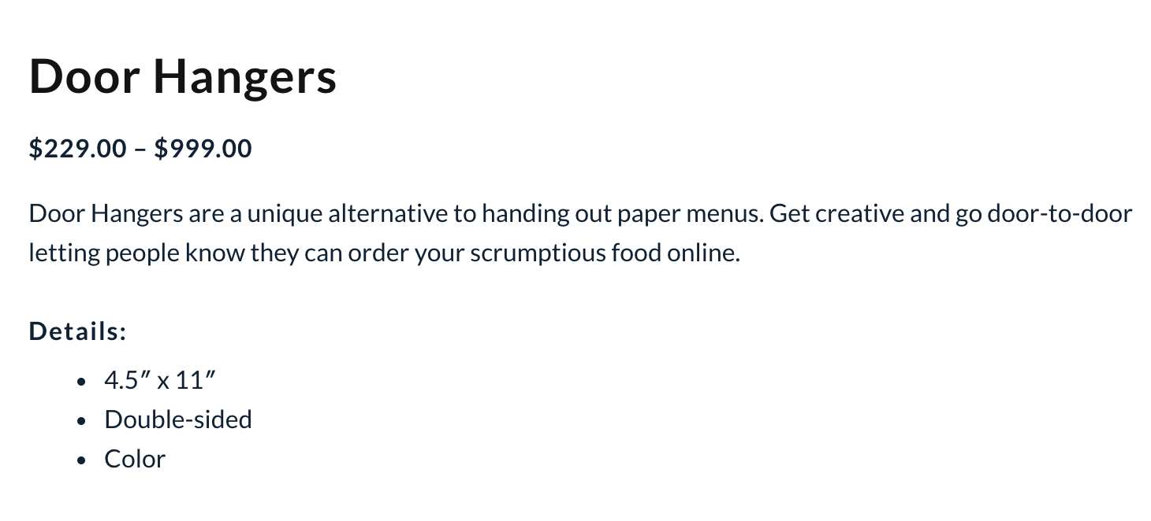
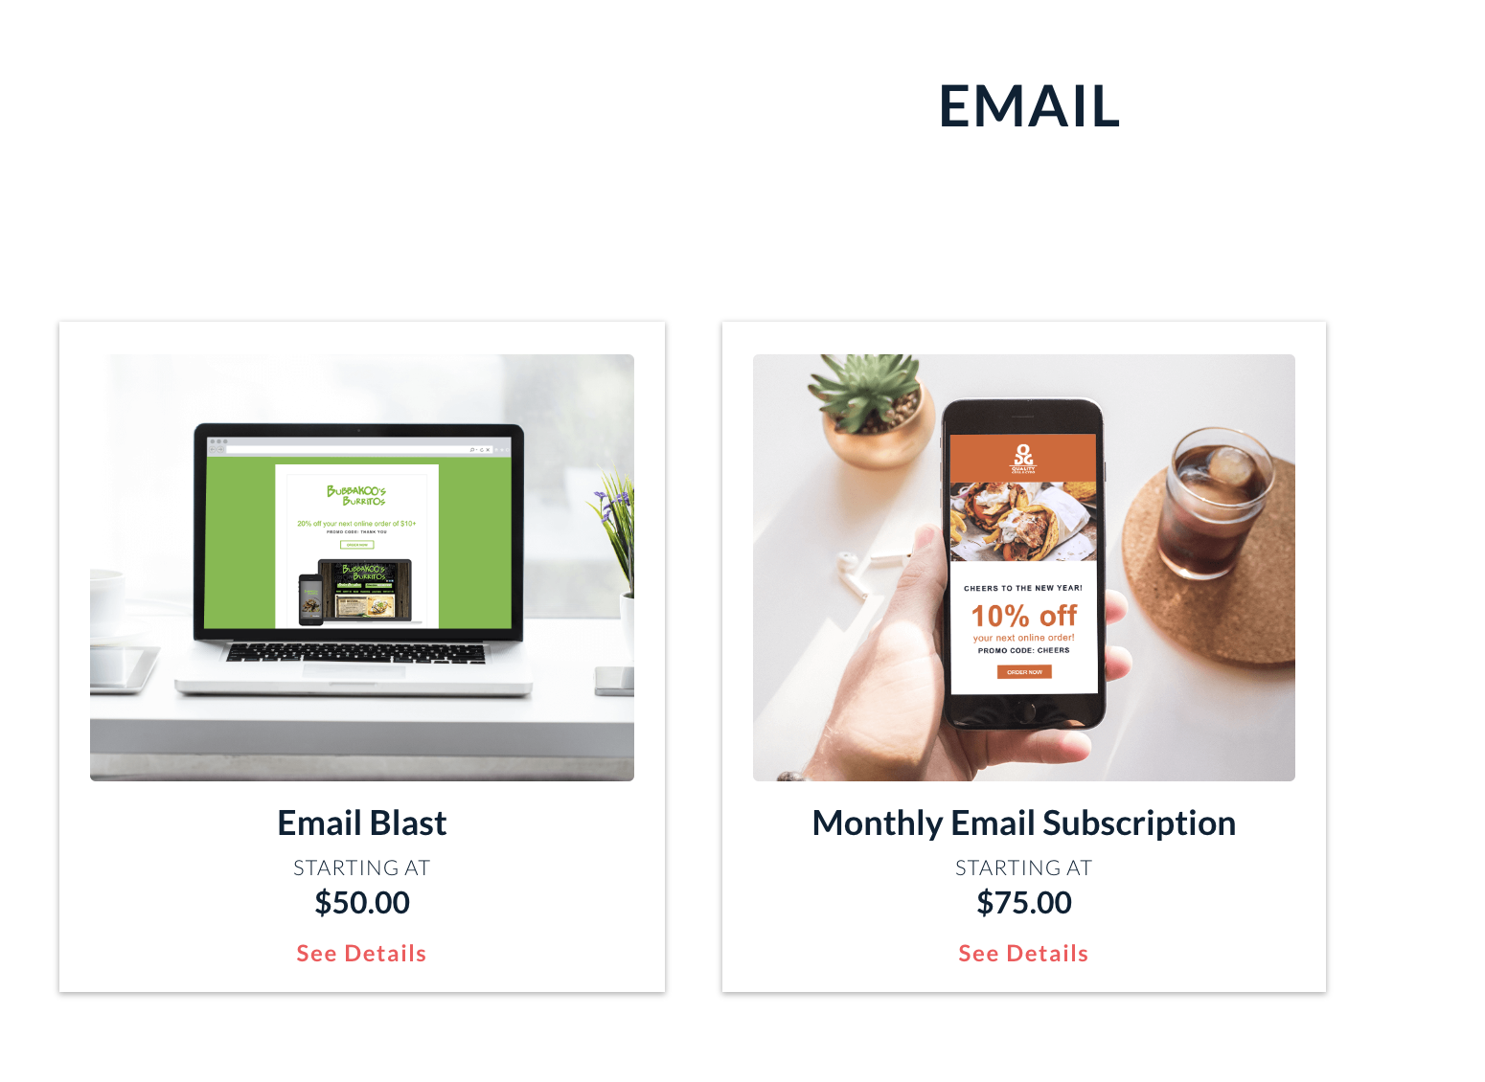
CHOWNOW MARKETING STORE EXAMPLE
Product descriptions are not using strategic keywords
Add Modals to help support and push upsells.
Hyperlink to related blog content or a piece of collateral.
Incorporate statistics and testimonials ot highlight and showcase the product’s value.
Notes:
Best practices for e-commerce + producrt desc
Just pointing out flaws

Slide 26
NEXT STEPS
Create a Client Lifecycle Growth Marketing Strategy and Content Roadmap
Work with the data to create better tracking and analytics for ChowNow’s Client Lifecycle programs and better assess email engagement.
Identify opportunities for automation and elimination in Yesware templates.
Revamp current emails in Milestones Program and add 24 new ones through the end of the year.
Notes:
Need a good idea of starting line. Now that have good understanding of current ecosystem, we know longer-term projects, quick wins, next part is using this audit info to inform where we’re going next + roadmap.
Now we have a good idea where we are, we can → APU, reduce churn, increase value of current restaurant portfolio

Slide 27
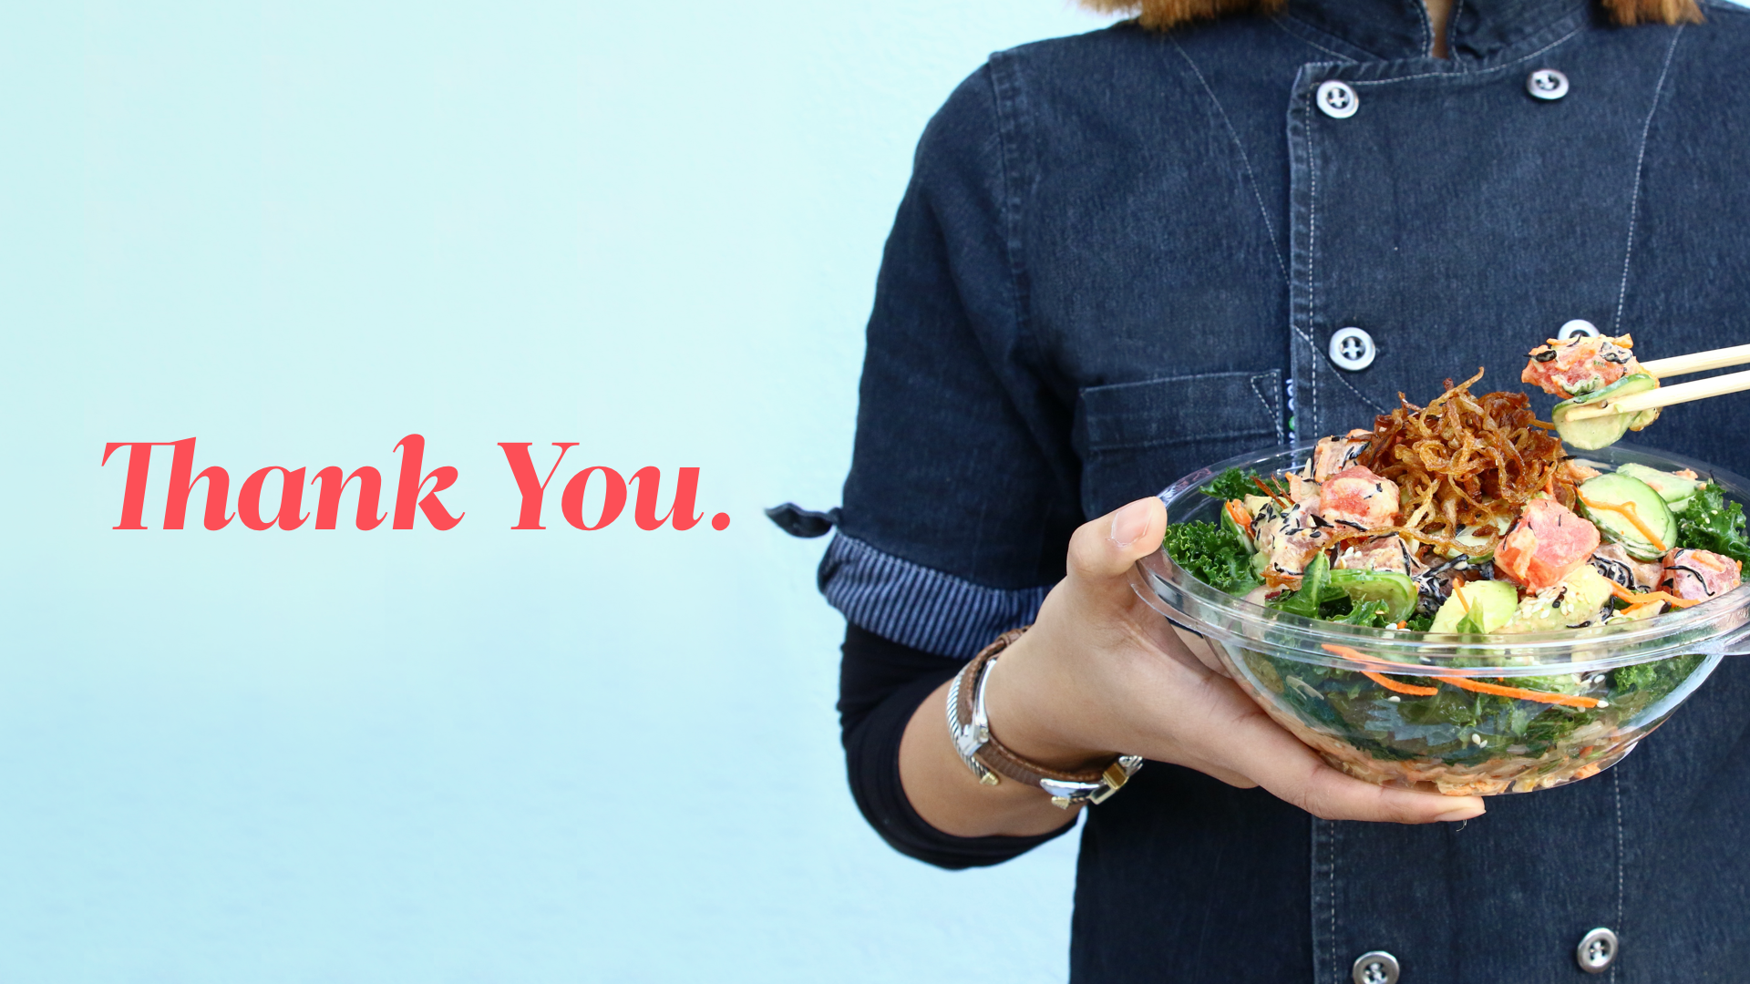

Slide 28
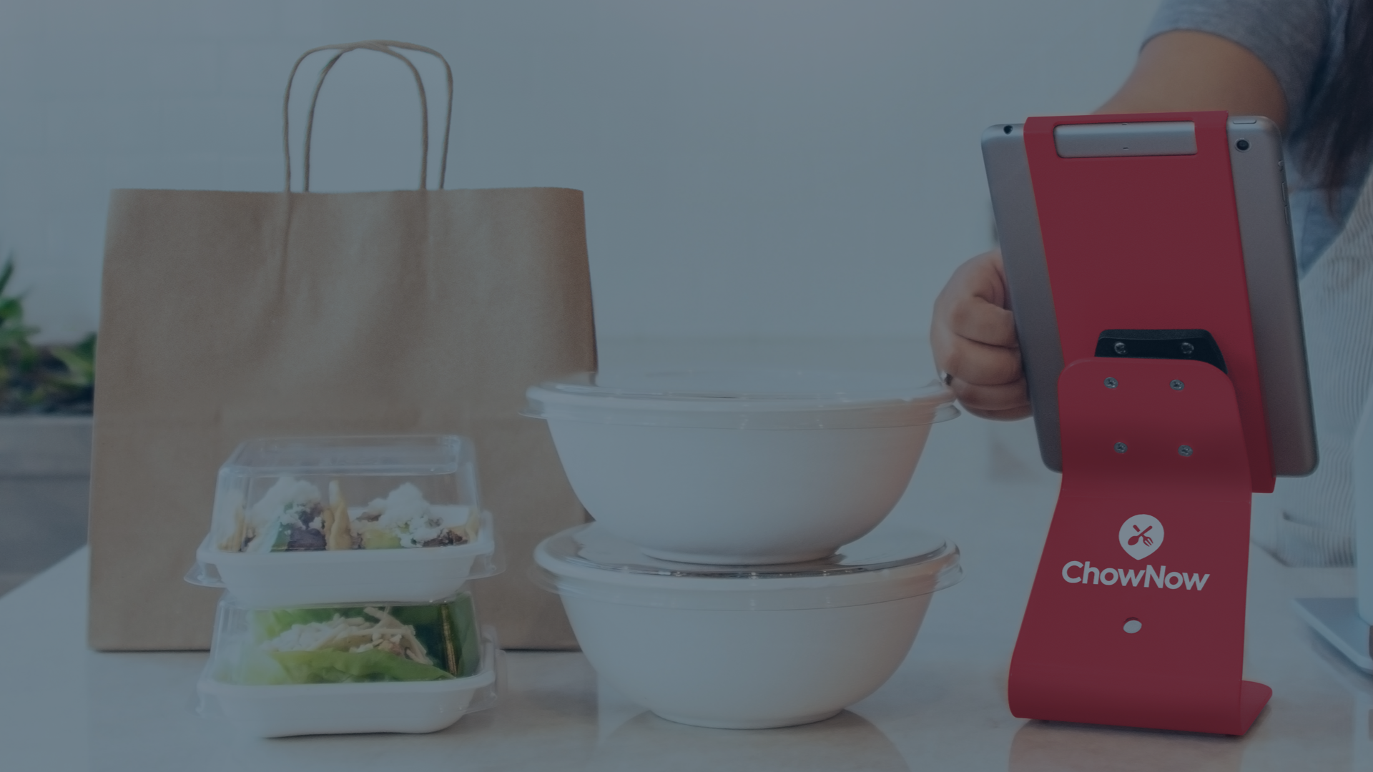
June 2018
Appendix

Slide 29
APPENDIX
Client Lifecycle Content Audit (Inventory List)
Milestone Email Program Copy and Cadence
Nurture Email Program Copy and Cadence
Live Links Collateral Doc
AC Marketing Survey Responses
RSM/RMM Marketing Survey Responses
ChowNow’s B2B marketing website and Marketing Store
Linked Content:
https://www.chownowstore.com/email/?utm_source=marketo&utm_medium=email&utm_content=body%2Fdashboard&utm_campaign=client%2Fmilestones%2F100customers
https://www.chownowstore.com/email/?utm_source=marketo&utm_medium=email&utm_content=body%2Fdashboard&utm_campaign=client%2Fmilestones%2F100customers
https://get.chownow.com/wp-content/uploads/4-Myths-About-Third-Party-Restaurant-Delivery-Busted.pdf
https://get.chownow.com/blog/why-third-party-marketplaces-want-your-restaurant-data/

